Slide 1

Churn Prediction Project Report
Customer churn, the phenomenon of customers discontinuing their business with a company, poses a significant challenge for businesses across various industries. This report delves into a churn prediction project focused on a telecommunications company, aiming to analyze customer data and predict the likelihood of churn based on various factors.

Slide 2
Data Overview
The dataset used in this project is the "Telco Customer Churn" dataset, encompassing a comprehensive collection of customer information, service details, and account data. This dataset provides valuable insights into customer behavior and allows for the development of predictive models to identify potential churners.
Customer Information
Gender, Senior Citizen, Partner, Dependents
Service Information
Phone service, Multiple lines, Internet service, Online security, Online backup, Device protection, Tech support, Streaming TV, Streaming movies
Account Information
Tenure, Contract, Paperless billing, Payment method, Monthly charges, Total charges
Target Variable
Churn (Whether the customer left in the last month)

Slide 3
Dataset Summary
The dataset comprises a total of 7,043 records, providing a substantial sample size for analysis. The target variable, "Churn," is a binary classification variable, indicating whether a customer has churned or not. The dataset includes both numerical and categorical features, with numerical columns representing metrics like tenure, monthly charges, and total charges, while categorical columns encompass service and account-related features, such as contract type, payment method, and internet service.
1
Total Records
2
Target Variable
3
Numerical Columns
7,043
Churn (binary classification)
Tenure, MonthlyCharges, TotalCharges
4
Categorical Columns
Service and account-related features, including contract type, payment method, etc.

Slide 4
Data Preprocessing
Data preprocessing is a crucial step in preparing the dataset for model training. This involves handling missing values, transforming data types, and splitting the data into training, validation, and testing sets.
1
Missing Values
Missing values were observed in the TotalCharges column due to spaces (' '), which were coerced into NaN using pd.to_numeric and then imputed with the median value. No other missing values were present.
2
Data Transformation
The Churn column was converted into binary integers (1 for "Yes", 0 for "No"). One-hot encoding was applied to transform categorical variables into numerical format for model training. Features like TotalCharges, MonthlyCharges, and tenure were standardized using StandardScaler.
3
Train-Test Split
The data was split into three sets: 60% Training for model building, 20% Validation for model tuning, and 20% Testing for final model evaluation.

Slide 5
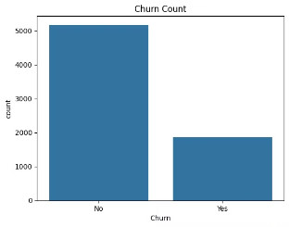
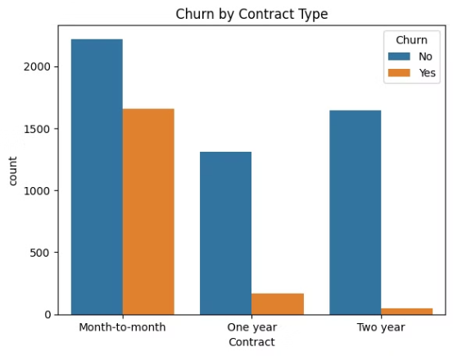
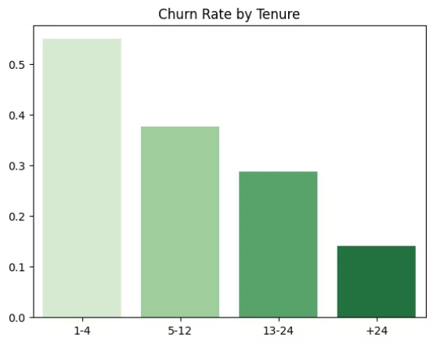
Exploratory Data Analysis (EDA)
Exploratory Data Analysis (EDA) is a critical step in understanding the dataset and identifying patterns and relationships that can inform model development. This involves visualizing the distribution of variables, exploring relationships between variables, and identifying potential outliers or anomalies.
Churn Distribution
Churn by Contract Type
Tenure and Churn
The distribution of the Churn column was visualized using a count plot, revealing that approximately 27% of customers in the dataset have churned, while 73% have remained.
The contract type has a strong influence on customer churn. The churn rate based on contract type was plotted, highlighting that month-to-month contracts have a significantly higher churn rate compared to longer-term contracts.
The churn rate decreases as tenure increases. The churn rate for different tenure groups was visualized by segmenting tenure into groups: Tenure 1-4 months (highest churn rate), Tenure 5-12 months (moderate churn rate), Tenure 13-24 months (lower churn rate), and Tenure > 24 months (lowest churn rate).

Slide 6
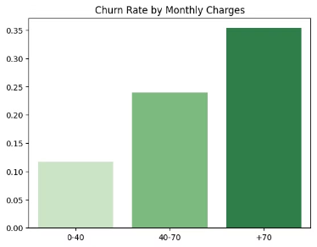

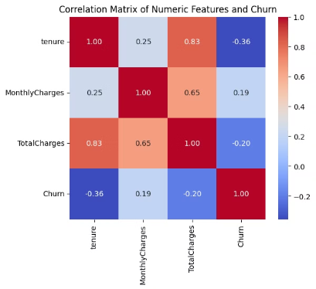
Monthly Charges and Churn
The churn rate is higher for customers with higher monthly charges. Customers with monthly charges above $70 have the highest churn rate.
Correlation Analysis
A heatmap was used to visualize the correlation between the numerical features and churn. The correlation between Churn and numerical features is relatively weak, but MonthlyCharges and tenure show a notable relationship.

Slide 7



Model Architecture
The model is built using Keras' Sequential API with the following layers: Input Layer (a dense layer with 16 units, ReLU activation, and L1-L2 regularization), Hidden Layers (three additional dense layers with 8, 4, and 2 units, respectively, each followed by Batch Normalization and Dropout for regularization), and Output Layer (a single neuron with a sigmoid activation function, suitable for binary classification).
Input Layer
Hidden Layers
Output Layer
A dense layer with 16 units, ReLU activation, and L1-L2 regularization.
Three additional dense layers with 8, 4, and 2 units, respectively, each followed by Batch Normalization and Dropout for regularization.
A single neuron with a sigmoid activation function, suitable for binary classification.

Slide 8

Model Evaluation
After training, the model's accuracy is evaluated on the test set. A classification report is generated, providing precision, recall, and F1-score metrics, which is displayed in a DataFrame format. The confusion matrix is computed and visualized using Seaborn's heatmap functionality, displaying the model's performance in a more intuitive manner.
K-Fold Cross-Validation
Model Saving
The application allows for K-Fold Cross-Validation (with 5 splits) when the "Train by K-Fold Cross-Validation" button is clicked. The model is retrained for each fold, and accuracies and classification reports for each fold are collected and displayed. The average accuracy across all folds is computed and displayed to give an overall sense of model performance.
The trained model is saved as a pickle file, allowing for future use or deployment.

Slide 9
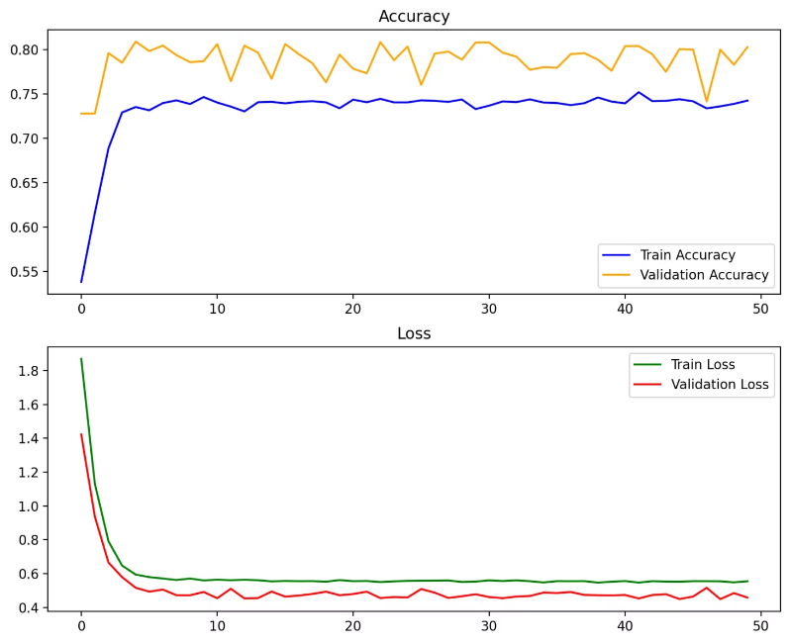
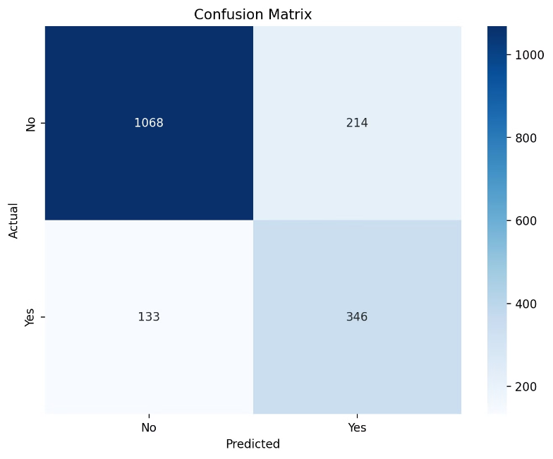
Visualization of Results
The application generates visualizations of: Training History (accuracy and loss curves for both training and validation sets) and Confusion Matrix (a heatmap indicating true positives, false positives, true negatives, and false negatives).

Slide 10
THANK YOU
Done By :
Omar Yasser, Youssef Osama, Hossam Mohamed

